Slide 1
Machine Learning in Spark
Dataset – MNIST dataset
Distributed processing on a Hadoop Cluster
Spark – PySpark, pyspark.mllib, Hadoop

Slide 2
Implementing KNN Classifier (without using libraries) in Spark
KNN is a simple algorithm to implement simple classification. The key of this algorithm is to find the class of nearest k neighbours and then to determine the class of test sample. In this project The KNN algorithm was implemented by following its procedure (and not by using methods available in ML library). The data was processed in distributed mode on several nodes of a Hadoop cluster. Appropriate design of parallelism is critical for the performance and accuracy point of view.
Following is the performance data on the distributed environment:

Slide 3
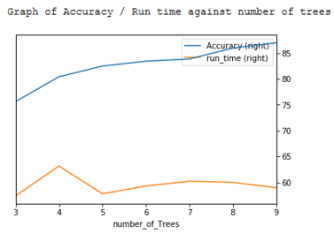
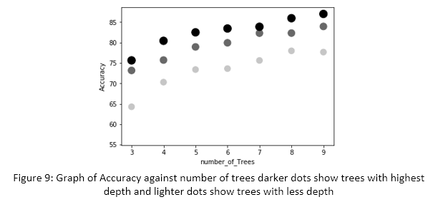
Implementing ML algorithms Naïve Bayes & Random Forest in Spark
Task was to perform classification on MNIST data set using Naïve Bayes & Random Forest algorithms. The processing is done on a Hadoop Cluster. Spark handles the data set as RDD (resilient distributed dataset) and does processing on multiple nodes in parallel.
The performance of random forests is shown as :

